Slide 1
Phase 2
Eliminating Dependencies and Increasing Showstoppers

Slide 2
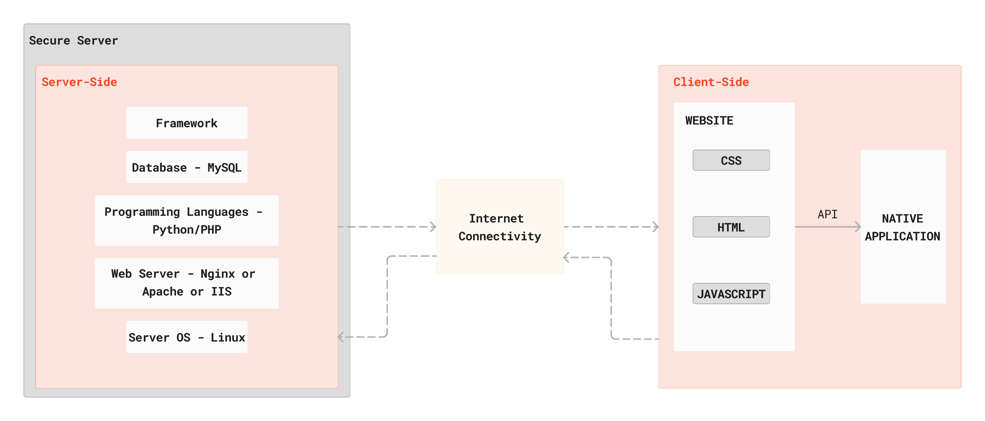
Refined Tech Stack:

Slide 3
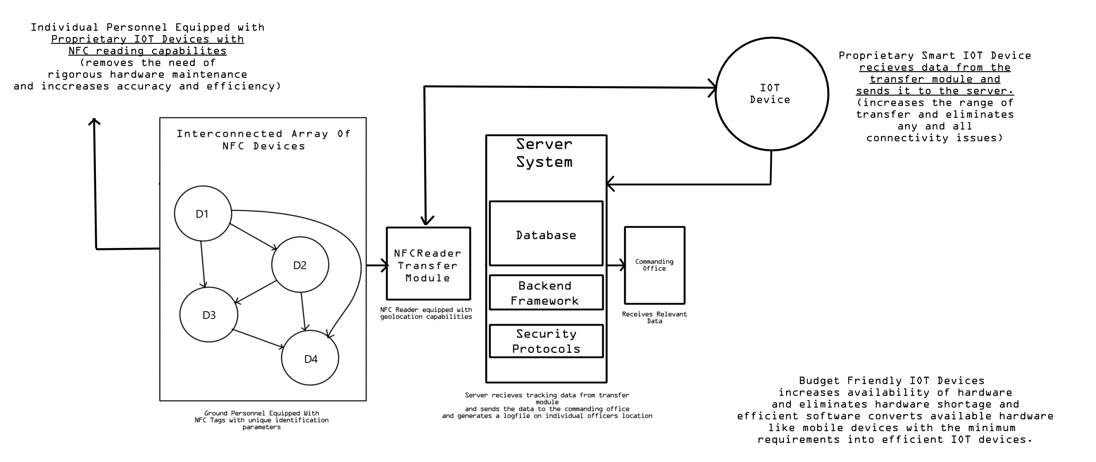
Availability Of Relevant Hardware, Maintenance of Hardware and Connectivity Issues:

Slide 4
Human Error:
Transfer Module has Integrated AI Image Processing Model along with an NFC reader for unique identity verification purposes. This eliminates the possibility of ground personnel exchanging NFC Tags as this model follows 2 Factor Authentication to verify that an NFC tag has been scanned by the person it was specifically assigned to.
Factor II → AI Model uses multiple images of an individual personnel to identify and verify the face identification of said personnel.
AI Image Processing Model
Transfer Module
Factor I → NFC tags with unique identification parameters are used to verify the personal identification of relevant details like name, ID, rank, etc. of a personnel.
AI Image Processing Model
NFC Reader

